Slide 1

D A T A P R O J E C T Data Breaches
Charnjot Singh

Slide 2
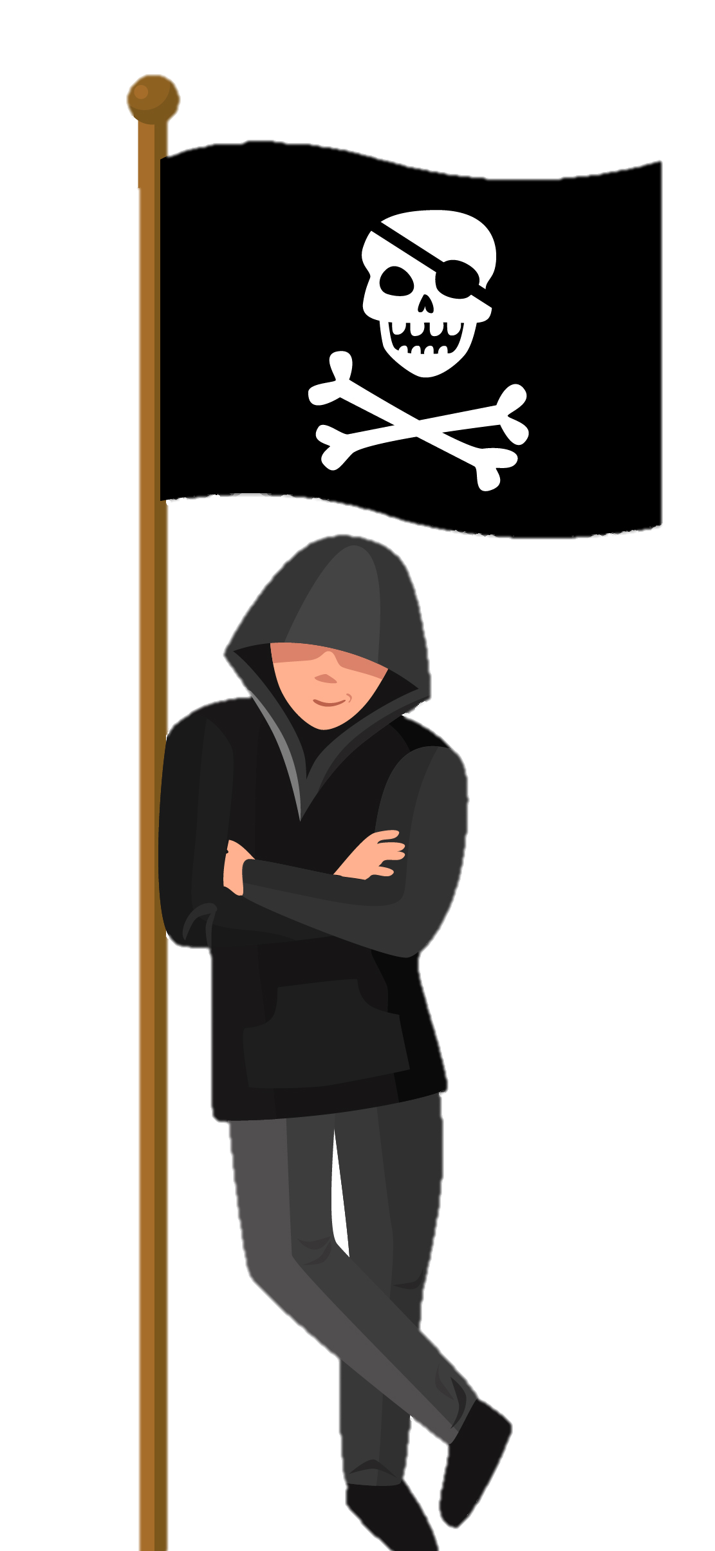
Healthcare Data Breaches
Importance:
Sensitive medical and personal information is involved
Consequences for patients and healthcare providers
Can lead to loss of trust in healthcare system
Impact:
Financial harm, emotional distress for patients
Legal consequences, loss of revenue for healthcare providers
Decreased patient trust, regulatory fines, increased costs for healthcare system
Goal:
Improve data security measures
Analyze and compare trends in data breaches
Prioritize actions to reduce risk of data breaches
Protect patient privacy, maintain trust, and reduce financial and legal consequences.

Slide 3
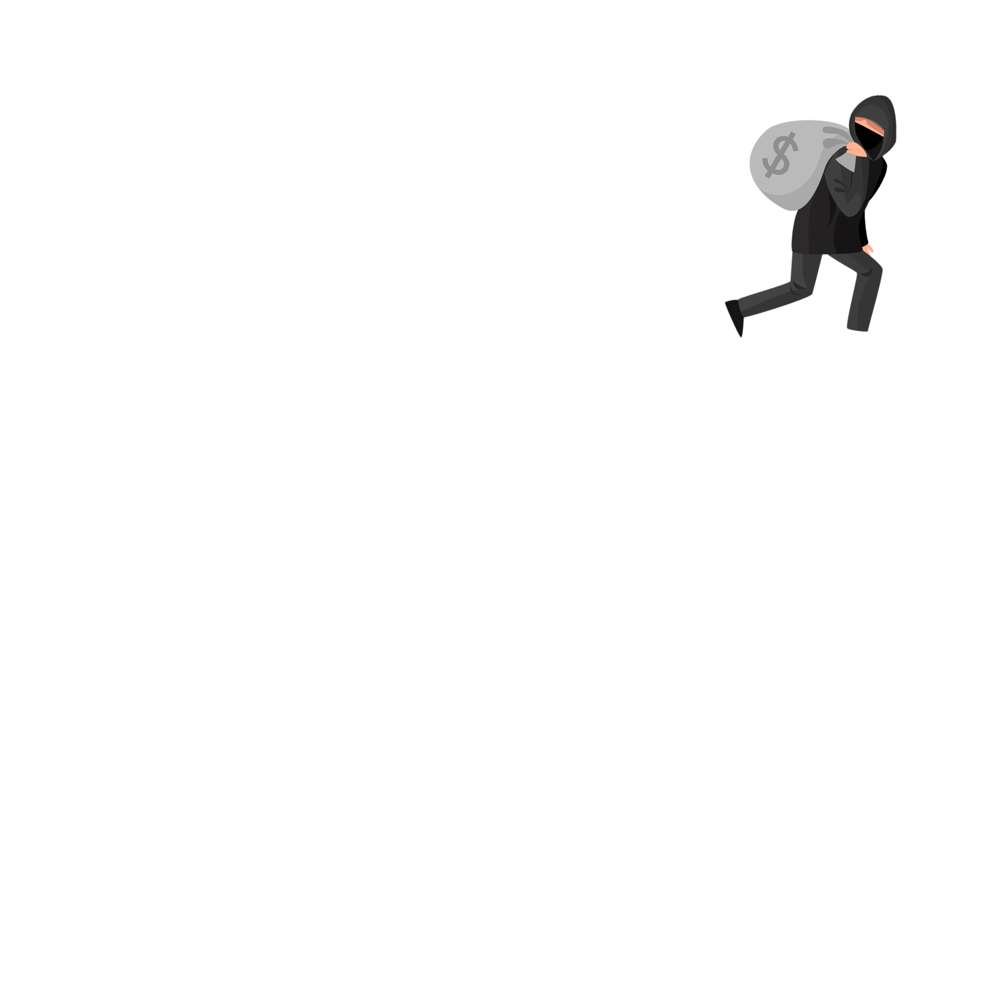

Types of Breaches
Hacking/data breach:
Involves unauthorized access to healthcare systems or networks.
Hackers exploit vulnerabilities in software or network infrastructure to gain access.
They may use techniques like phishing, malware, or brute force attacks.
Hackers can steal patient records, medical history, social security numbers, or financial information.
These breaches can have severe consequences, including identity theft, financial fraud, or medical fraud.
Email or loss/theft:
Occurs when sensitive healthcare information is compromised through email communication or physical loss/theft of devices.
Email breaches can happen when employees send sensitive data to the wrong recipient or fall victim to phishing scams.
Physical loss/theft can involve stolen laptops, mobile devices, or physical files containing patient data.
Such breaches can lead to unauthorized access to medical records, exposing patients to privacy risks.
Lost or stolen devices may also result in data loss if the information is not properly encrypted or protected.

Slide 4
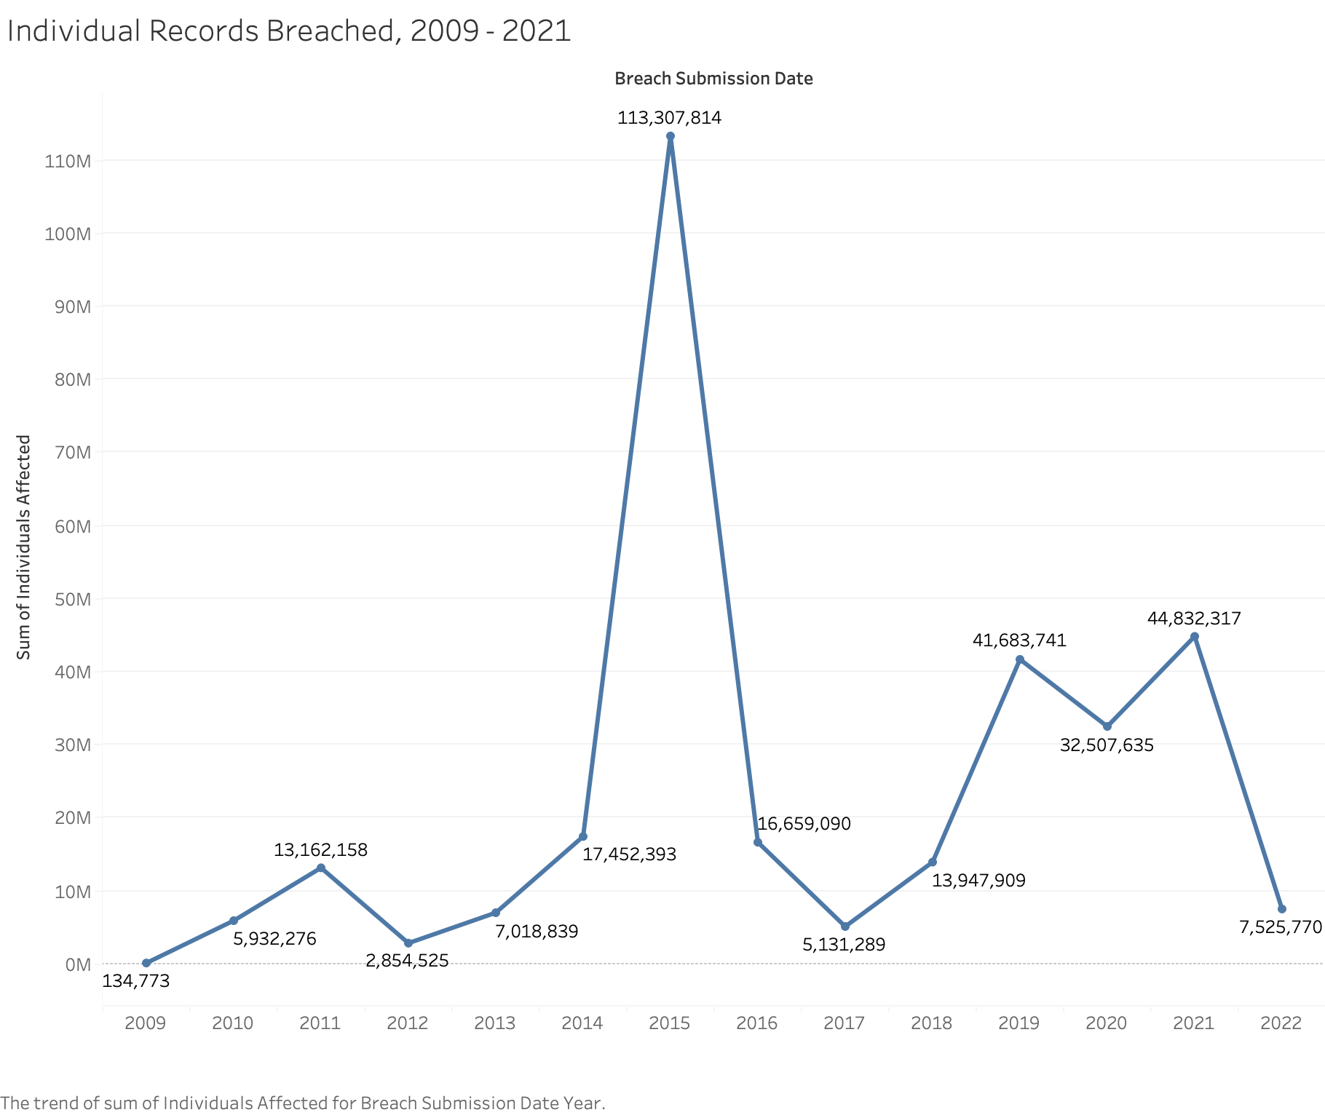
Line Graph
This line graph depicts individual records breached from 2009 to 2022. It reveals that the most people were breached in 2015, with 113,307,814. The lowest was 134,773 in 2009

Slide 5
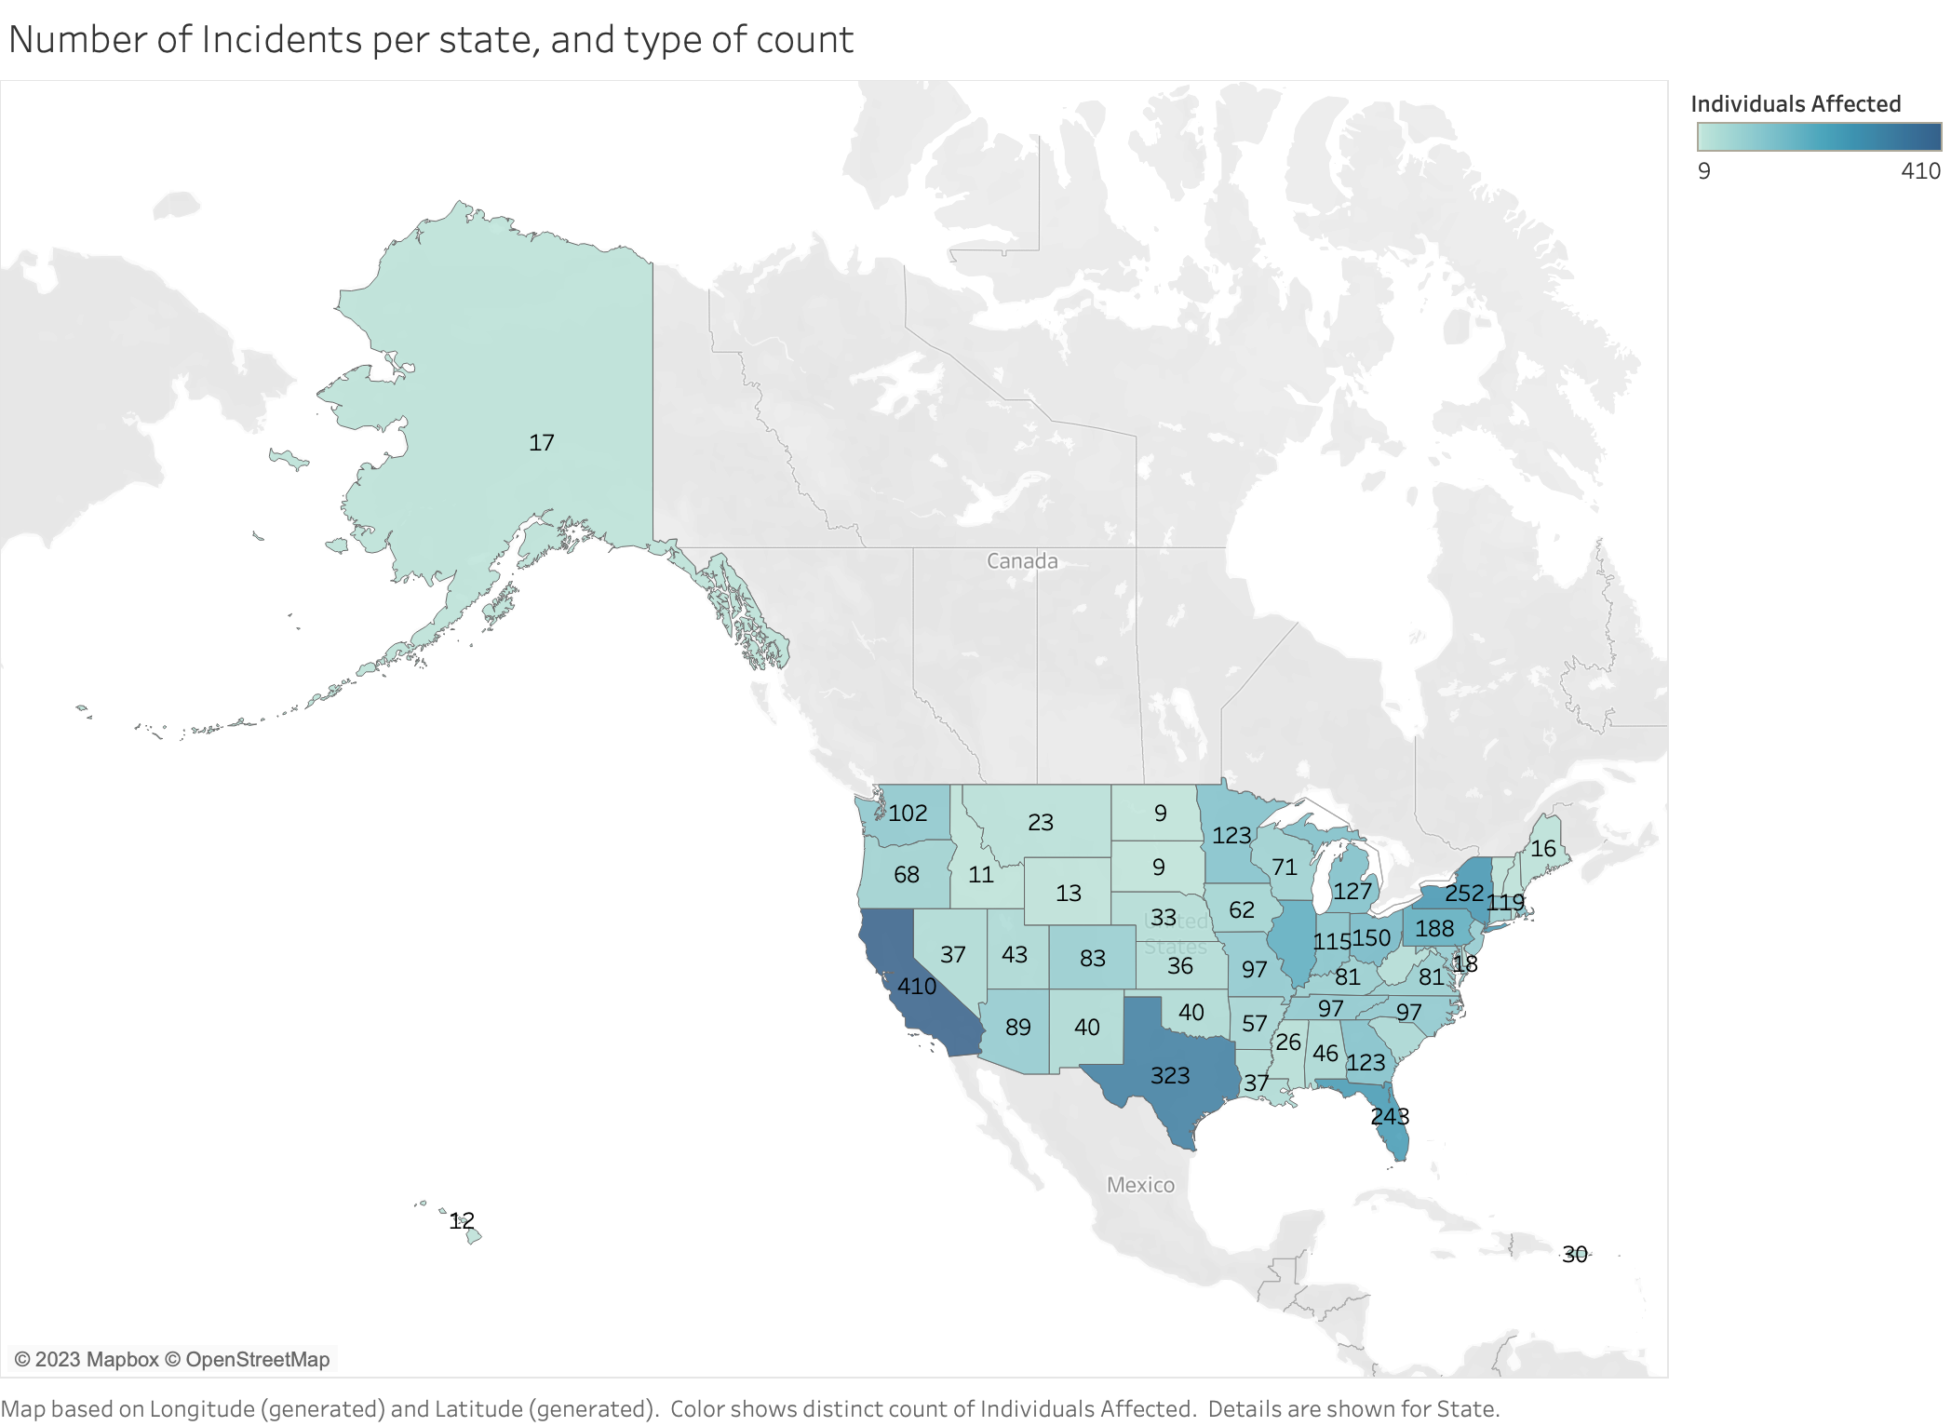
Map Graph
This map graph depicts the amount of incidents per state and the type of count. California had the most incidences (410), North and South Dakota had the fewest, and Virginia had the most (81).

Slide 6
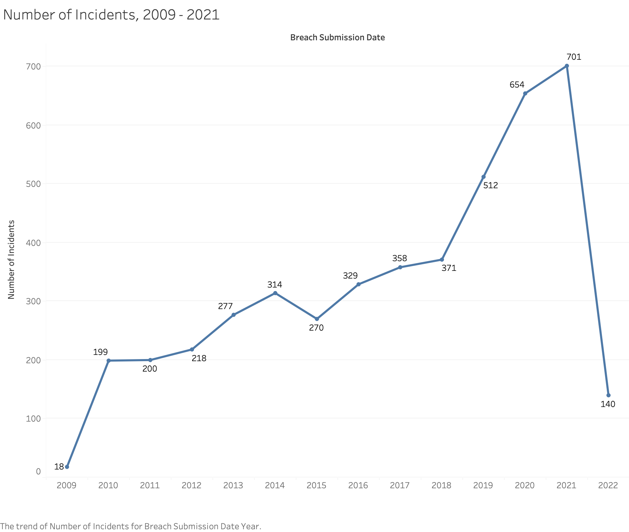
Line Chart
This line chart shows the number of incidents and the year the breaches happened, with the number of incidents pointed out on the graph.

Slide 7
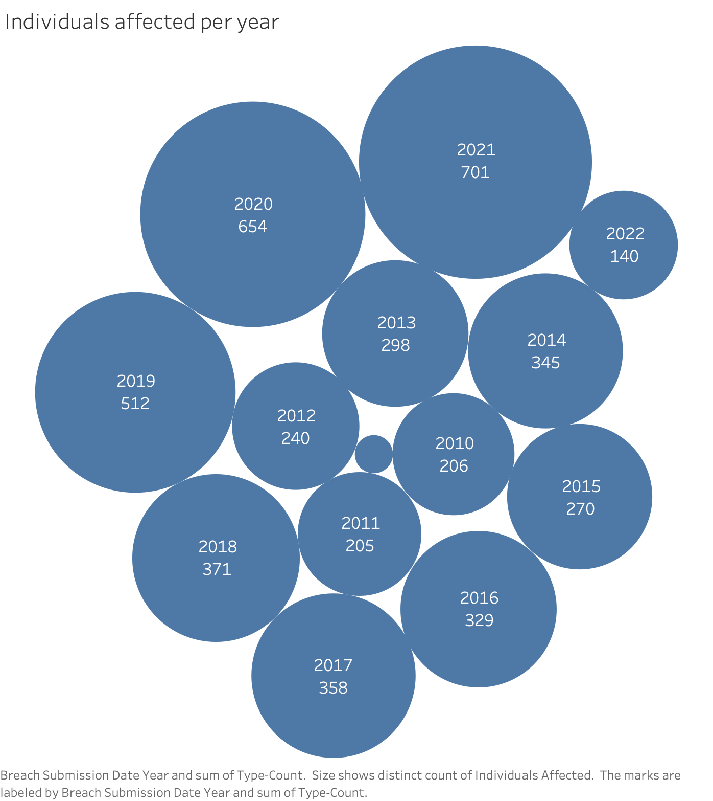
Packet Bubble Chart
This packet bubble chart displays the number of people affected each year. It reveals that the most individuals were impacted in 2021, with 701 affected, and the fewest in 2009, with 17 affected.

Slide 8
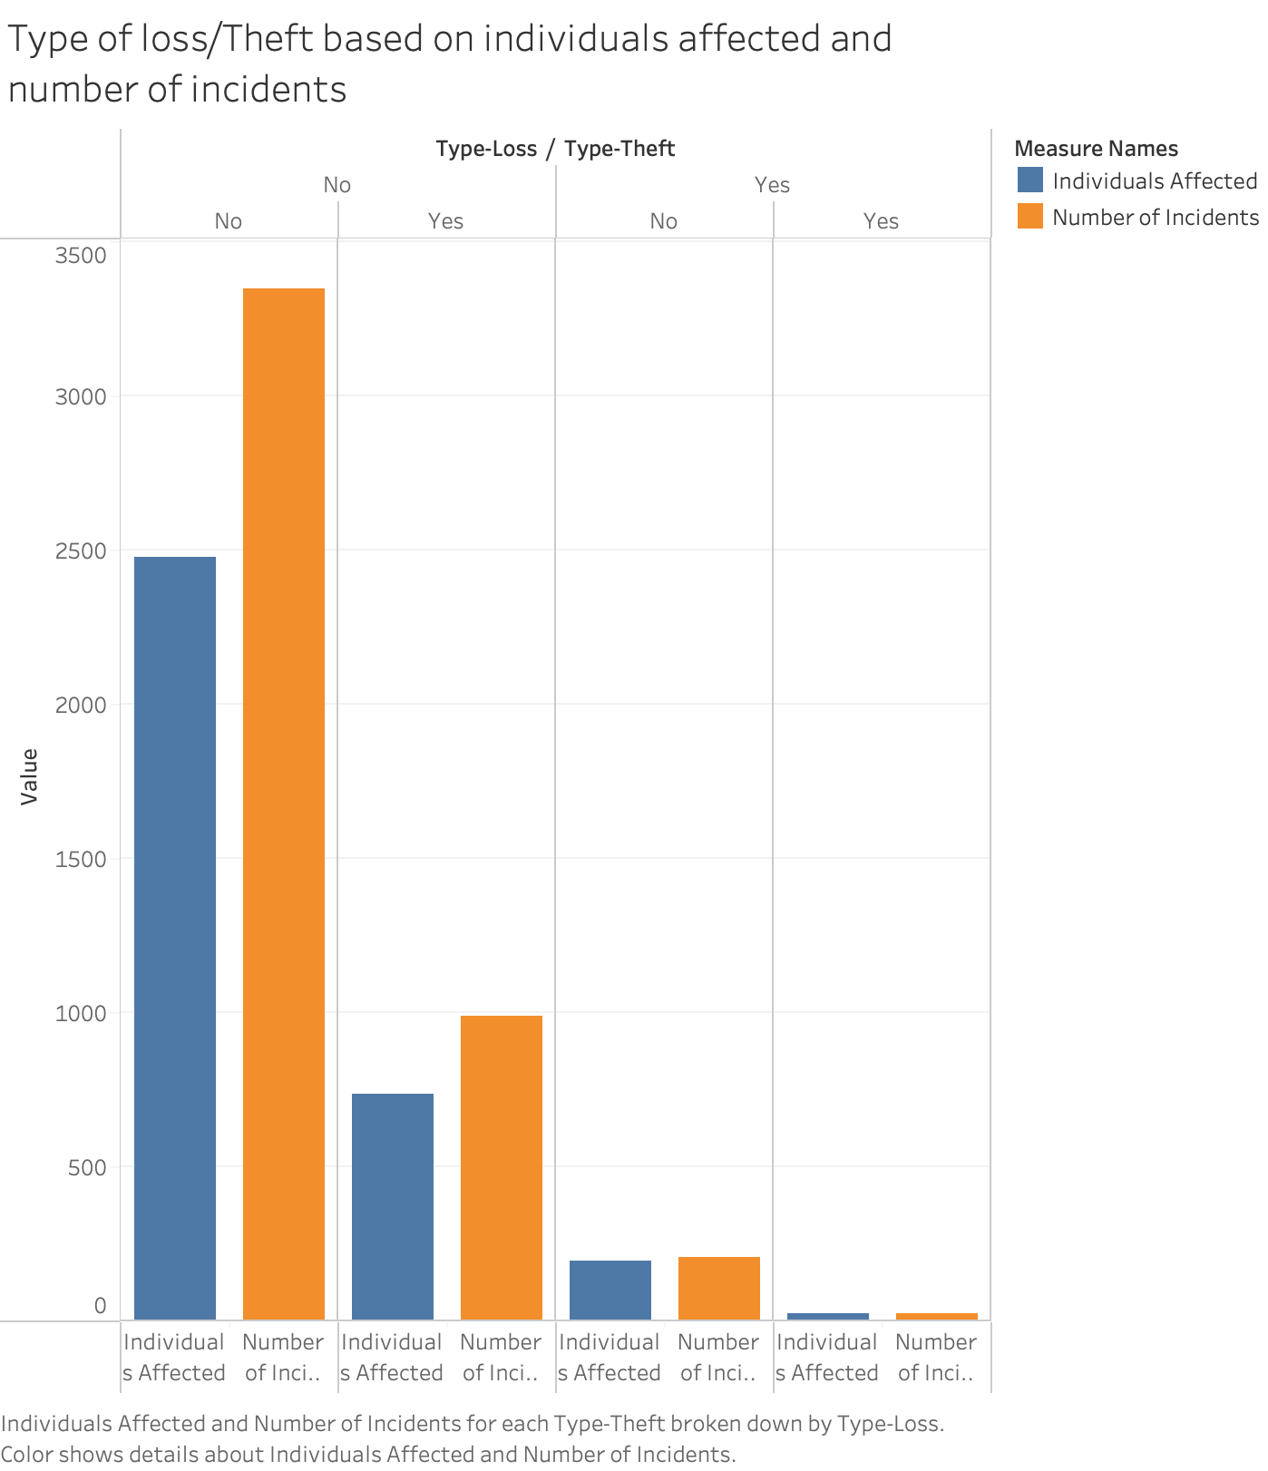
Side-by-side Bar Chart
This is a side-by-side bar chart that shows the type of loss/theft based on the number of incidents and the number of persons impacted. The blue hue represents the number of people affected, while the orange color represents the number of incidents.

Slide 9
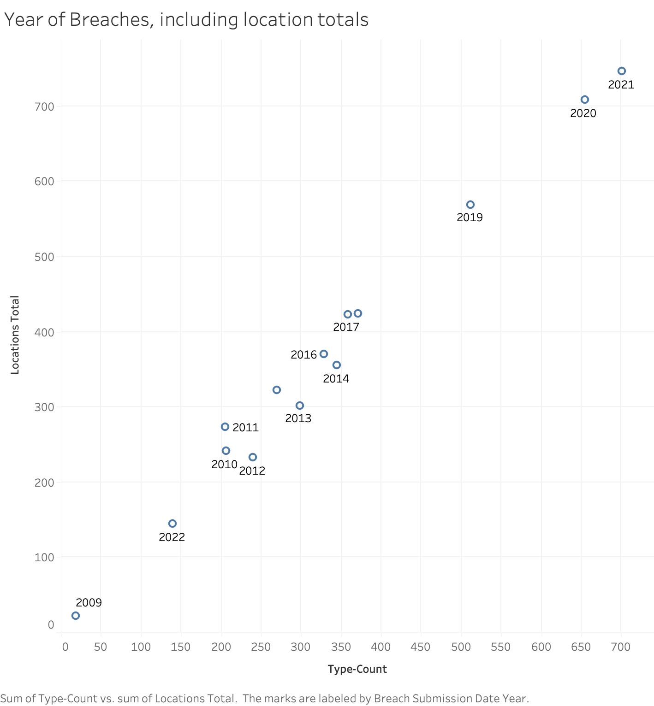
Scatter Plot
This is a scatter plot. It displays annual breaches from 2009 to 2021, including location totals.
As time goes by, more and more people are affected by the breaches. As shown in the graph, it increased from 2009 to 2021 at its highest.

Slide 10
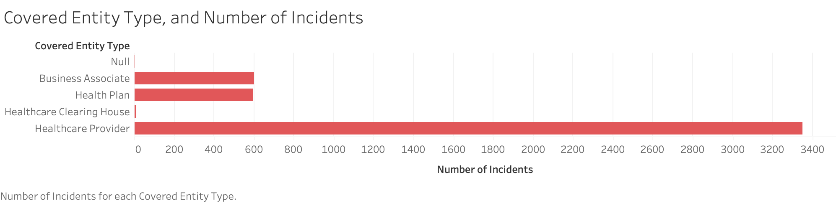
Horizontal Bars Graph
This is a horizontal bars graph in which the categories of entities are disclosed and the number of breach instances are stated; in this case, Healthcare Providers have the most breach incidents, while Healthcare Clearing Houses have the fewest.

Slide 11
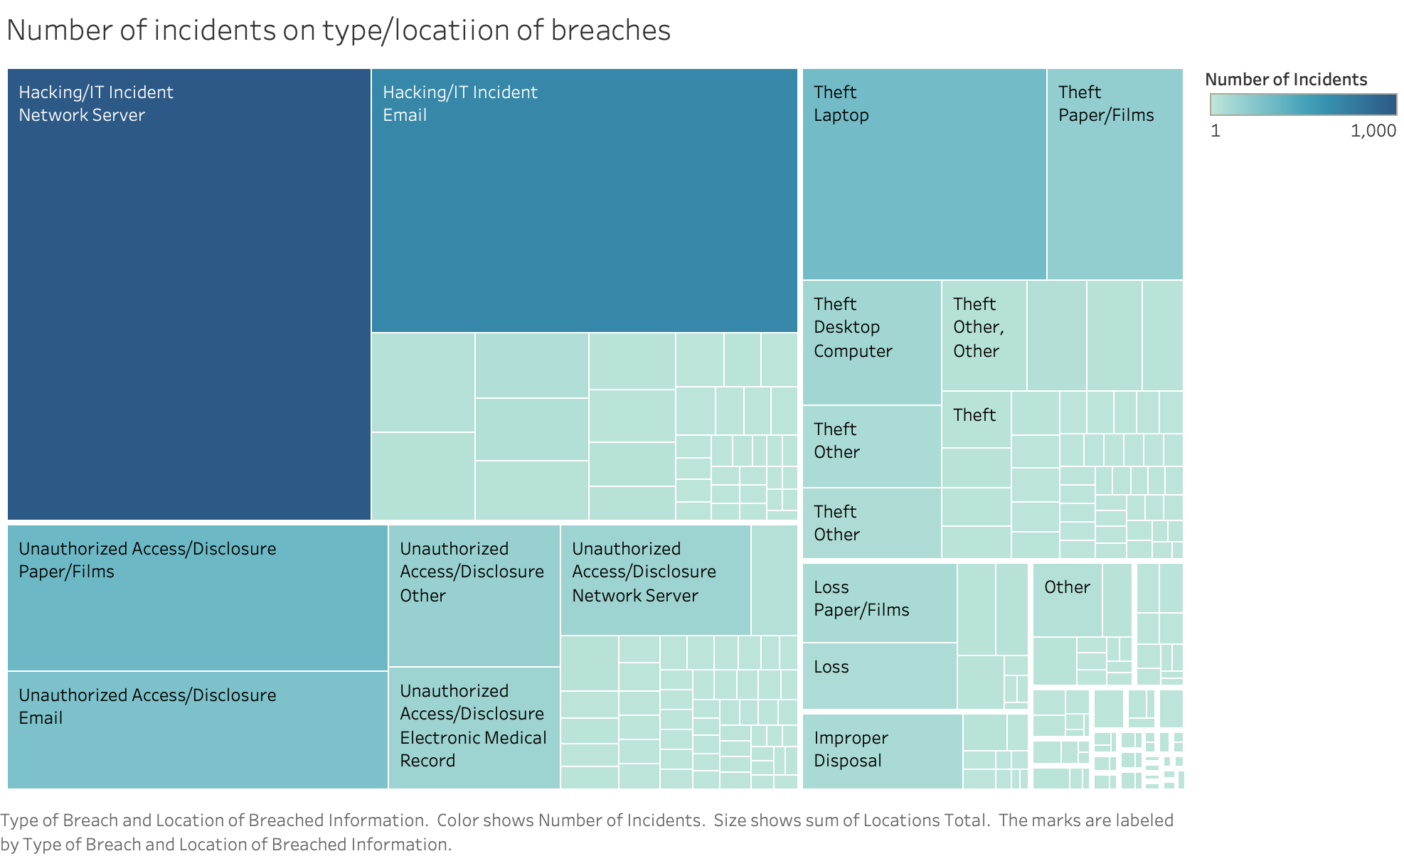
TreeMaps
This is Treemaps. It demonstrates that hacking/IT incidents through network servers and email have a higher number of incidents than theft of electronic equipment and loss of paper/films.

Slide 12
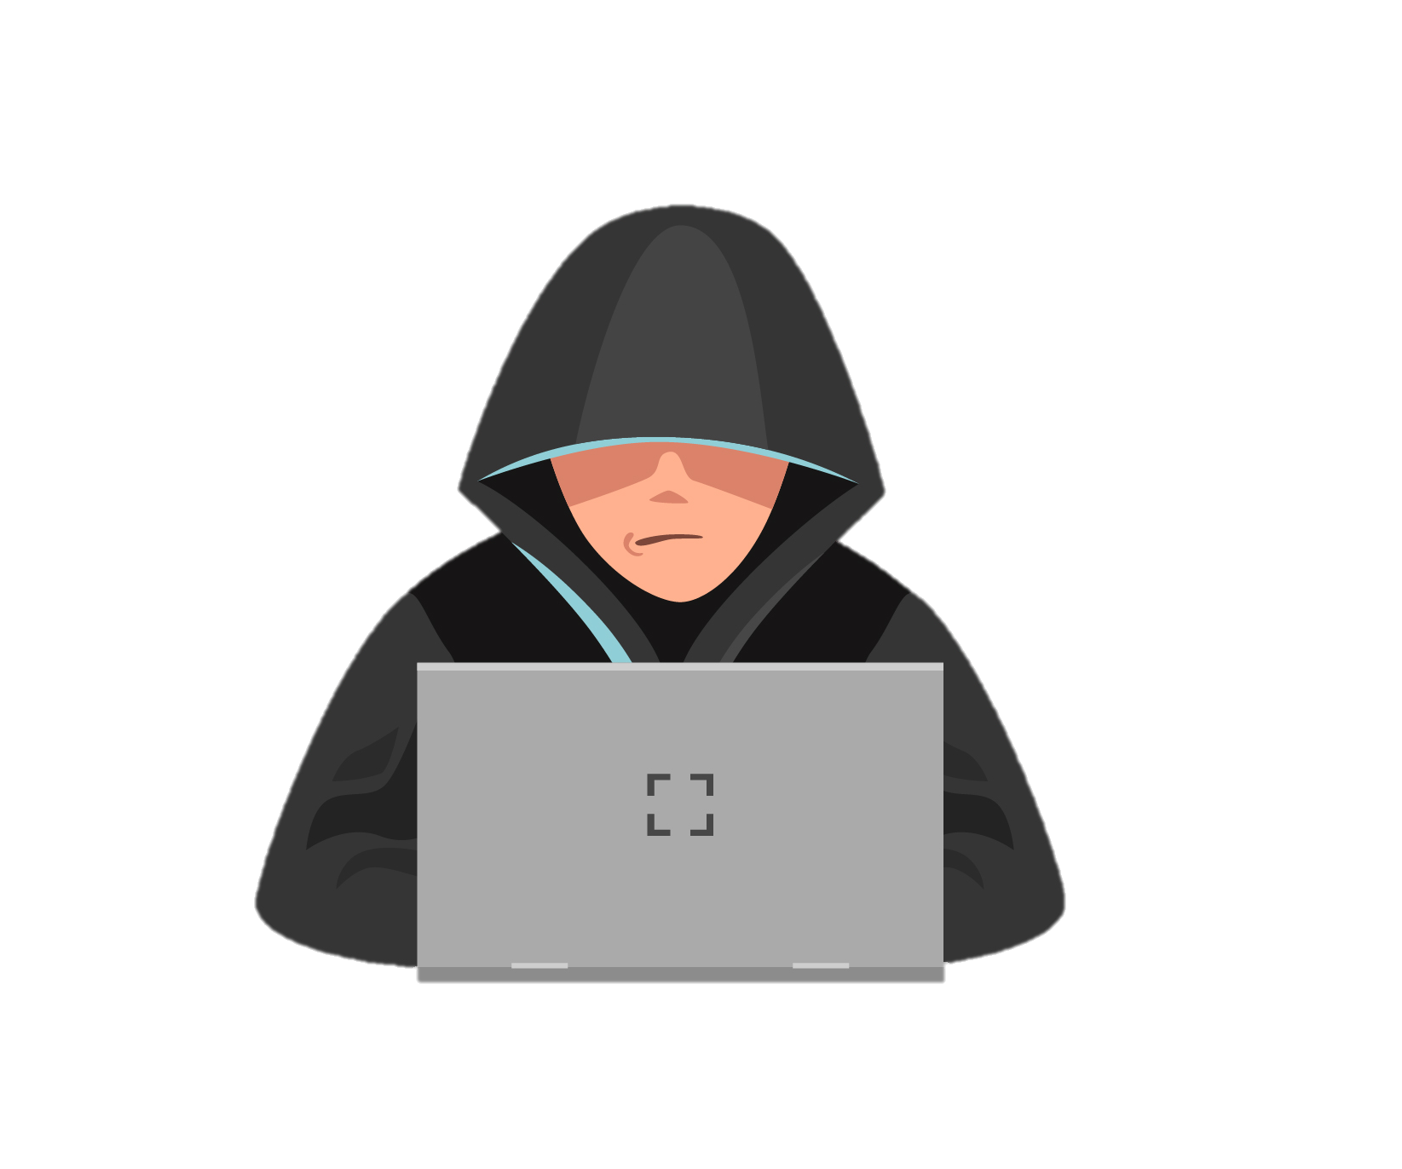
Finding
The line graph reveals a peak in breached individual records in 2015, reaching 113,307,814, and a low point of 134,773 in 2009.
According to the map graph, California experienced the highest number of incidents (410), while North and South Dakota had the fewest. Virginia topped the count with 81 incidents.
The line chart effectively displays the year-wise distribution of breach incidents, highlighting the specific number of incidents for each year.
The packet bubble chart indicates that 2021 witnessed the highest impact on individuals, with 701 affected, whereas the lowest impact was seen in 2009, with only 17 individuals affected.
The side-by-side bar chart illustrates the relationship between incident types and the number of people impacted. The blue color represents the number of individuals affected, while the orange color represents the number of incidents.
The scatter plot demonstrates a consistent increase in annual breaches from 2009 to 2021, with the highest level recorded in the latter year.
Over the years, the number of individuals affected by breaches has shown a steady rise, as evidenced by the graph.
In the horizontal bars graph, Healthcare Providers stand out with the highest number of breach incidents,
whereas Healthcare Clearing Houses have the lowest count.
The line graph depicts the prevalence of different breach types and their impact on individuals.
Hacking/IT incidents dominate, followed by illegal access/disclosure, theft, and loss.
The Treemaps visually represent the predominance of hacking/IT incidents through
network servers and email, surpassing incidents involving theft of electronic equipment
and loss of paper/films.

Slide 13

Cases (HIPAA Violation Cases 2023)
Banner Health
The HHS' Office for Civil Rights has imposed a financial penalty of $1,250,000 on Banner Health for alleged HIPAA Security Rule violations.
Banner Health, a large non-profit health system in the US, experienced a security breach in 2016, exposing the protected health information (PHI) of 2.81 million individuals.
Investigators found long-term and pervasive noncompliance with the HIPAA Security Rule within Banner Health, leading to the imposition of the financial penalty.
Banner Health must adopt a corrective action plan, including conducting a thorough risk analysis, developing a risk management plan, and implementing policies and procedures to enhance data security and protect against unauthorized access to PHI.
Life Hope Labs, LLC
The HHS' Office for Civil Rights (OCR) has settled its first HIPAA enforcement action of 2023 with Life Hope Labs, LLC, resulting in a $16,500 penalty.
The enforcement action highlights the importance of providing individuals and their personal representatives with timely access to their medical records as mandated by the HIPAA Right of Access.
OCR's HIPAA compliance initiative has targeted organizations that failed to provide requested medical records promptly and those that charged unreasonable fees for access to records, resulting in penalties for 43 healthcare organizations.
Life Hope Labs, a diagnostic laboratory, violated the HIPAA Right of Access by delaying the provision of requested medical records for seven months. As part of the settlement, Life Hope Labs must implement a corrective action plan, including the development of written policies and employee training on HIPAA Privacy Rule compliance.

Slide 14
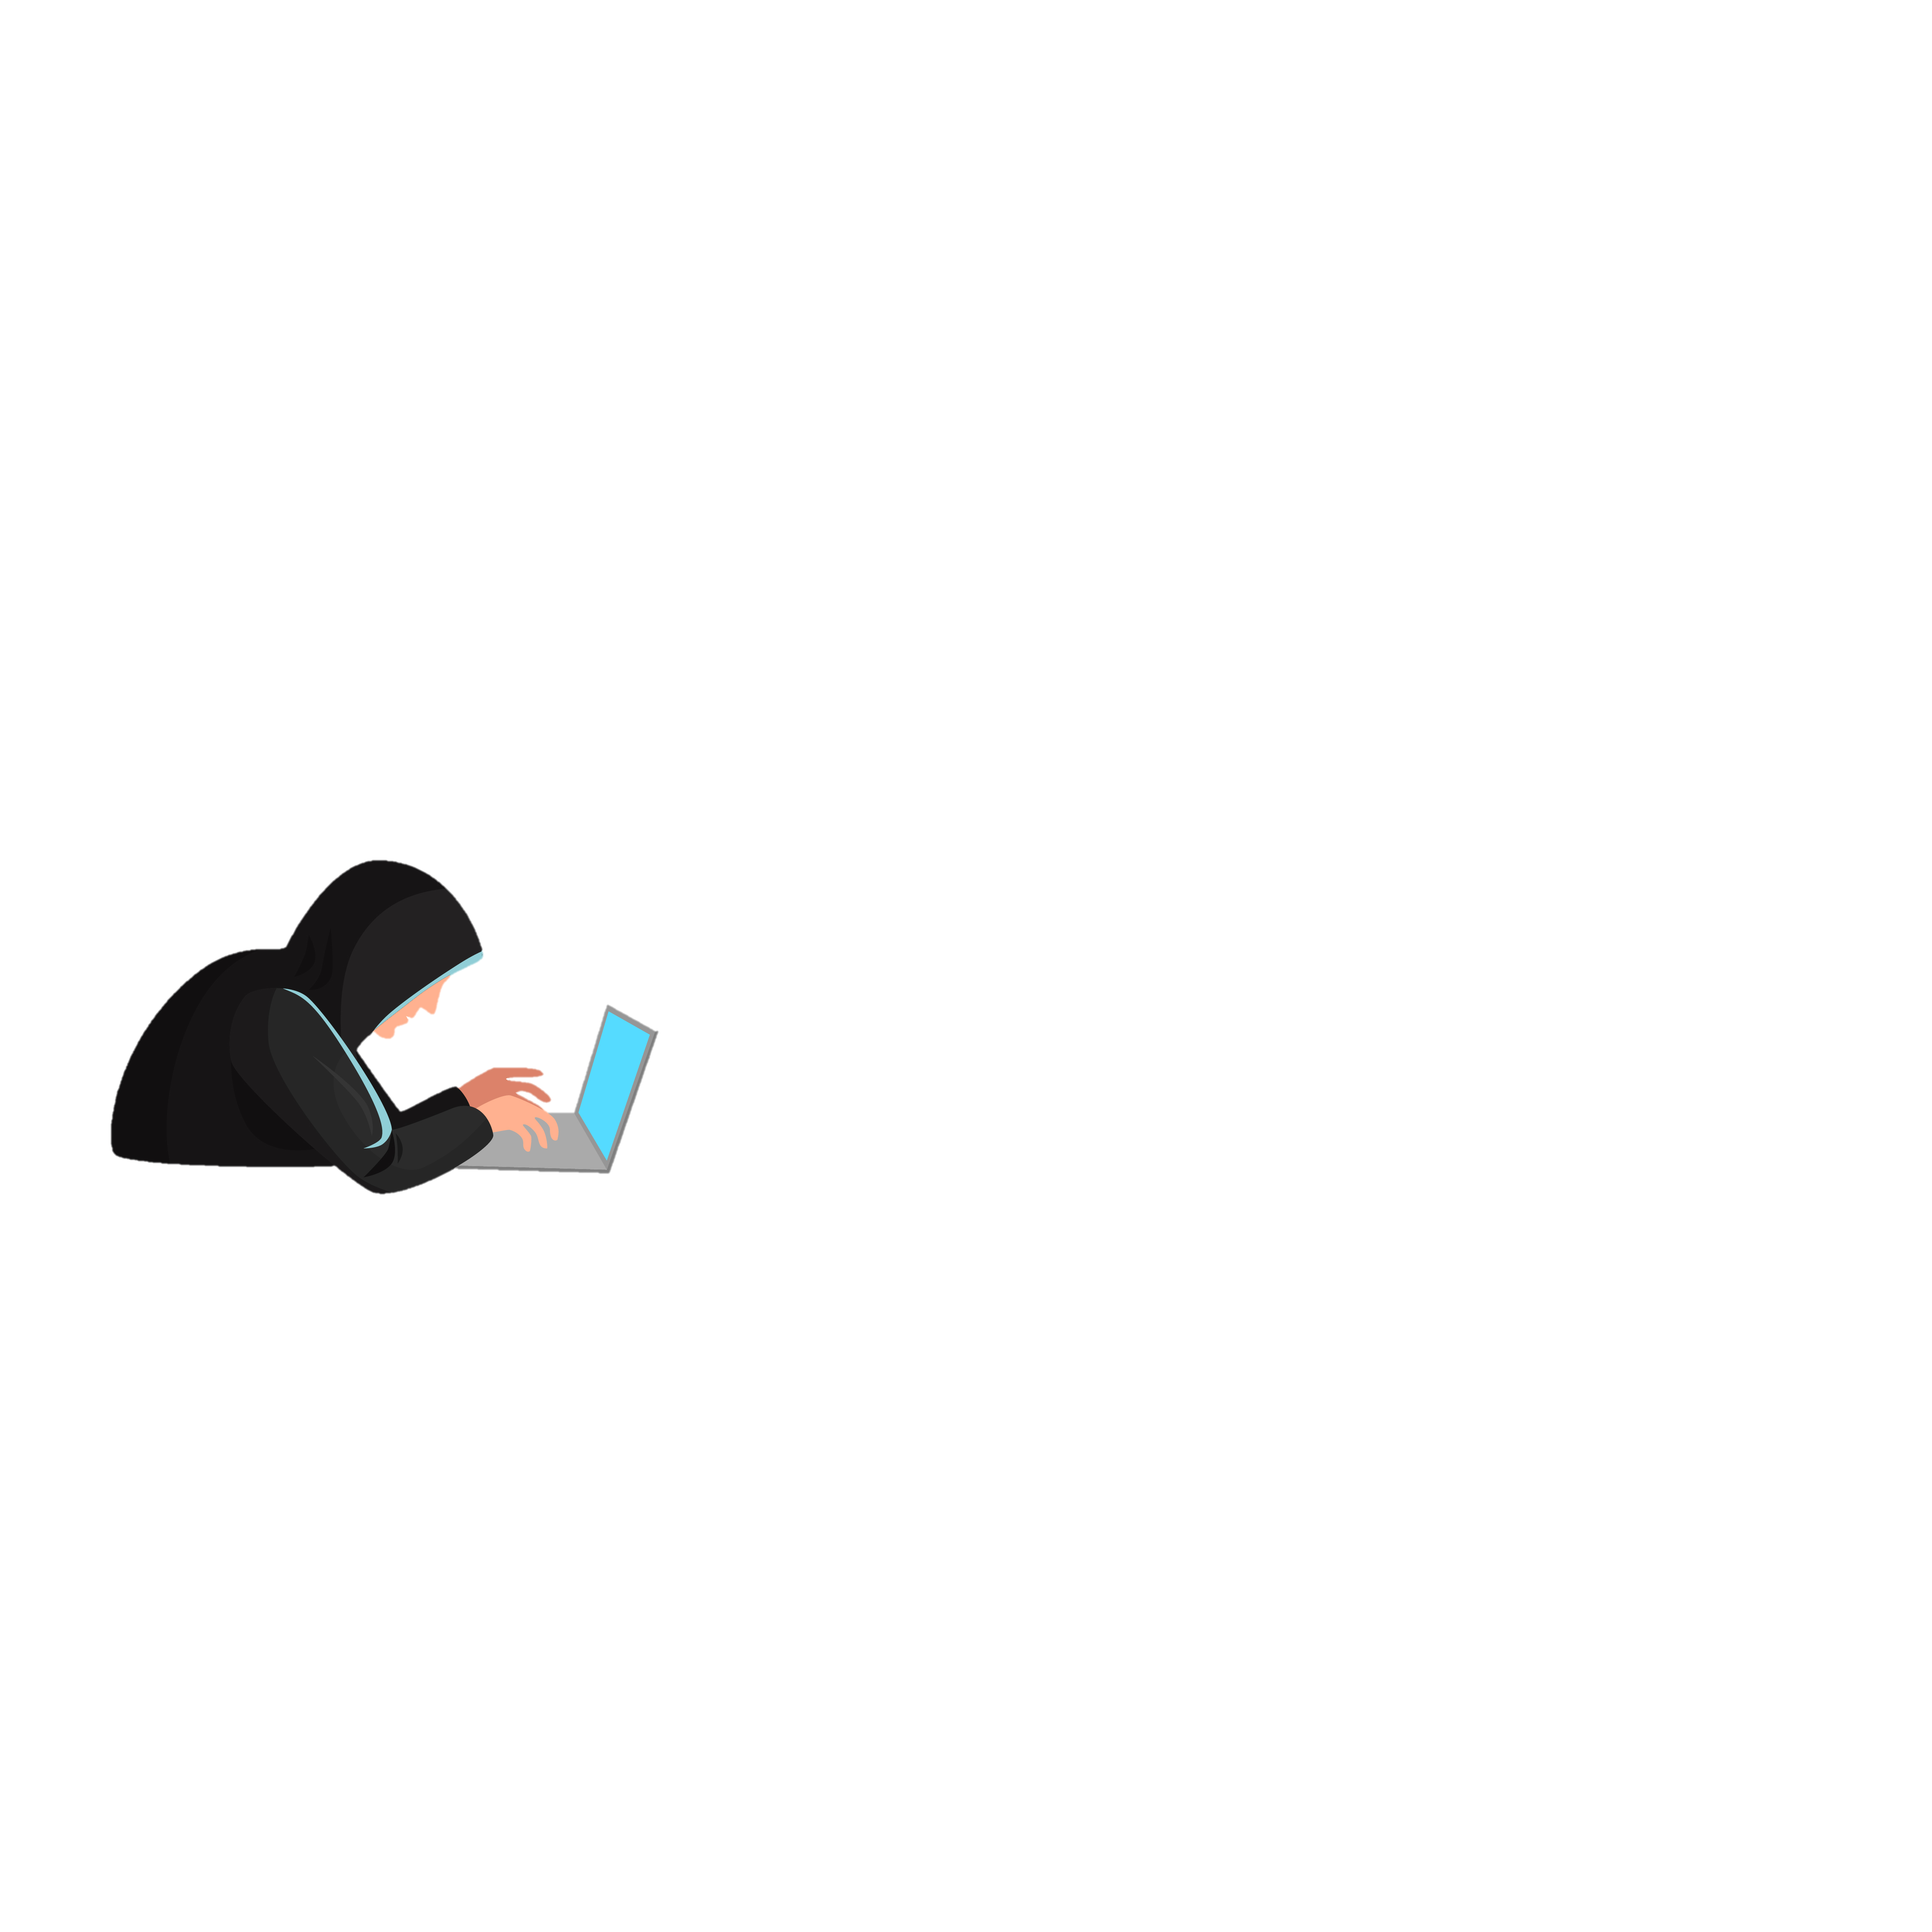
Preventions
Implement robust security measures: Utilize encryption, access controls, firewalls, and secure networks to protect sensitive data from unauthorized access and cyber threats.
Conduct regular risk assessments: Perform comprehensive evaluations of systems and processes to identify vulnerabilities, assess potential risks, and implement appropriate safeguards to mitigate data breach risks.
Educate and train employees: Provide comprehensive cybersecurity training to all staff members to raise awareness about data security best practices, including strong password management, recognizing phishing attempts, and handling sensitive information securely.
Maintain strong incident response protocols: Establish and regularly review an incident response plan that outlines clear steps to be taken in the event of a data breach, including notification procedures, containment measures, and recovery strategies.
Stay updated with regulations: Stay informed about evolving data protection laws and regulations, such as HIPAA, and ensure compliance with their requirements, including timely reporting of breaches and implementing necessary security measures.

Slide 15
References
10 ways to prevent a healthcare data breach. Applied Medical Systems. (2022, December 5). https://appliedmedicalsystems.com/10-ways-prevent-healthcare-data-breach/
Big Data Security and Privacy Issues in healthcare | IEEE conference ... (n.d.). https://ieeexplore.ieee.org/abstract/document/6906856
Data breaches: In the healthcare sector. CIS. (2021, July 14). https://www.cisecurity.org/insights/blog/data-breaches-in-the-healthcare-sector#:~:text=Breaches%20are%20widely%20observed%20in,lost%20laptops%20or%20other%20devices.
HIPAA Journal. (2023a, January 4). Diagnostic lab settles medical record access case for $16,500. HIPAA Journal. https://www.hipaajournal.com/diagnostic-lab-settles-medical-record-access-case-for-16500/
HIPAA Journal. (2023b, February 3). Banner health settles alleged HIPAA security rule violations for $1.25 million. HIPAA Journal. https://www.hipaajournal.com/banner-health-settles-alleged-hipaa-security-rule-violations-for-1-25-million/
HIPAA violation cases - updated 2023. HIPAA Journal. (2023c, May 13). https://www.hipaajournal.com/hipaa-violation-cases/
Most common types of healthcare data breaches. Definitive Healthcare. (n.d.). https://www.definitivehc.com/resources/healthcare-insights/most-common-healthcare-data-breaches#:~:text=What%20are%20the%20common%20sources,2019%20to%2022.9%25%20in%202020.
Seh, A. H., Zarour, M., Alenezi, M., Sarkar, A. K., Agrawal, A., Kumar, R., & Khan, R. A. (2020, May 13). Healthcare data breaches: Insights and implications. Healthcare (Basel, Switzerland). https://www.ncbi.nlm.nih.gov/pmc/articles/PMC7349636/

